Slide 1

DATA SCIENCE INDUSTRY
COMPENSATION ANALYSIS

Slide 2

TEAM
Ananyaa Shahi
Anushka Mondal
Vivid Liu
Bhakti Kate

Slide 3

AGENDA
Introduction
Problem Statement & Objective
Data Reading
Data Cleaning
Exploratory Data Analysis
Data Modeling
Conclusion

Slide 4

INTRODUCTION

Slide 5

DATASET: DATA SCIENCE JOB SALARIES
Encompasses 11 key columns capturing multifaceted aspects of job compensation within the realm of data science, covering a wide range of experience levels and job titles.
The dataset includes information such as:
work year
experience level and type
salary amount
employee residence country
remote work ratio
company location and size
Source: https://www.kaggle.com/datasets/arnabchaki/data-science-salaries-2023

Slide 6

WHY THIS DATASET ?
Aligns with our data science and analytics career goals, providing real and valuable insights tailored to our field.
Quality data sourced from aijobs.net, a reputable platform specializing in AI, Machine Learning, and Data Science jobs.
Enhances our proficiency in Python, statistics, data handling, analysis, and visualization skills.

Slide 7

PROBLEM STATEMENT & OBJECTIVE

Slide 8

PROBLEM STATEMENT :
The Data Science industry is vast and has several factors affecting its entirety.
In this project, we would be determining the key elements that influence the variation in salaries for professionals in the data science and related fields in 2023.
Also, can we predict or analyze salary trends based on these attributes for 2024?
OBJECTIVE :
The project will provide actionable recommendations, empowering us to make informed career decisions.

Slide 9

DATA READING

Slide 10
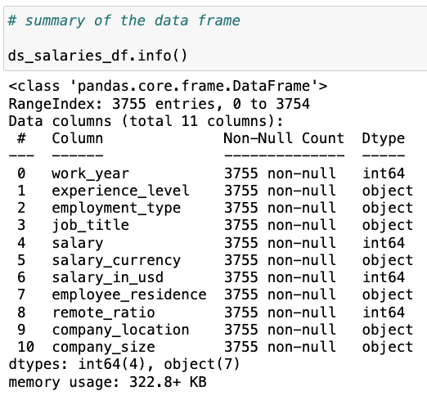
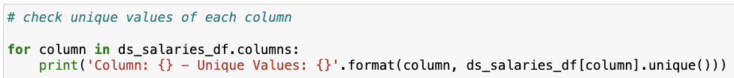
Summary
Notable unique values
Work years: 2020, 2021, 2022, 2023
Experience levels: Entry-level, Senior, Middle, Executive
Employment types: Full-Time, Contractor, Freelancer, Part-Time
Remote ratios: 100, 50, 0
Company sizes: Small, Medium, Large

Slide 11

DATA CLEANING

Slide 12
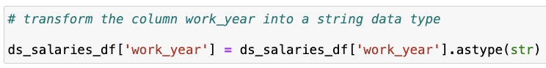
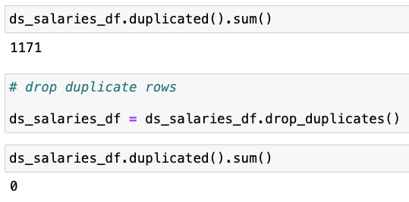
Transformation
The work_year column initially had int64 data type. Since no arithmetic operations is performed on the work_year column, we have transformed the data type to string.
2. Remove duplicates
A total of 1171 duplicate rows were found. After dropping, 2584 unique rows were obtained.
.

Slide 13
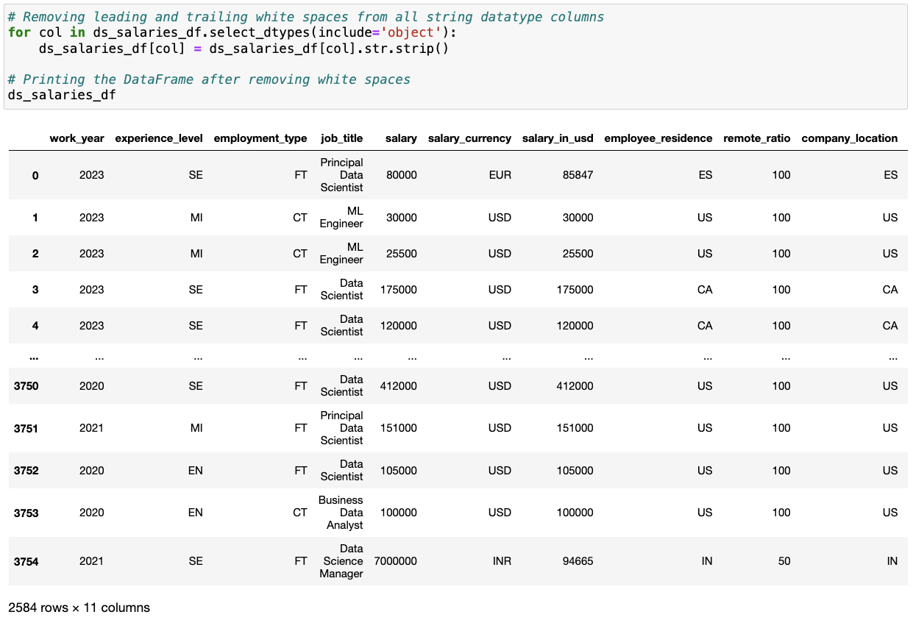
3. Remove leading and trailing white spaces
Trimming leading/trailing spaces in datasets ensures data consistency for accurate analysis, sorting, and filtering, improving overall reliability.

Slide 14
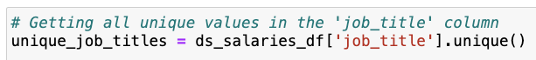
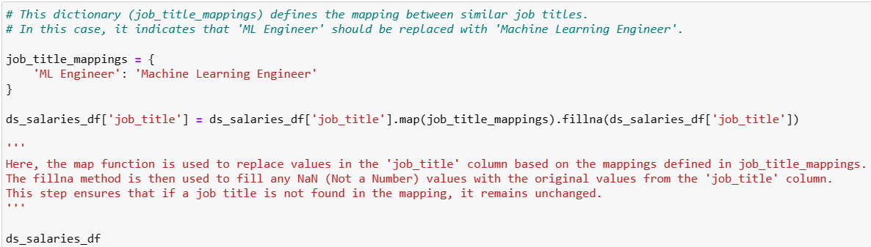
4. Replacing abbreviation in job titles
Initially, there were 93 unique job titles. However, there was a subtle repetition that could have affected the result of the analysis.
After replacing the abbreviation ML Engineer with its full form Machine Learning Engineer, we got 92 unique job titles.

Slide 15
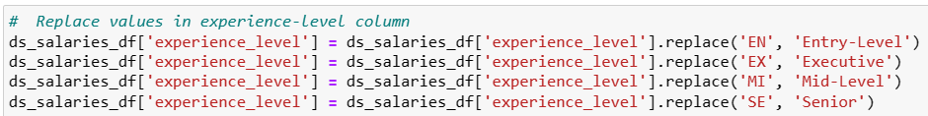
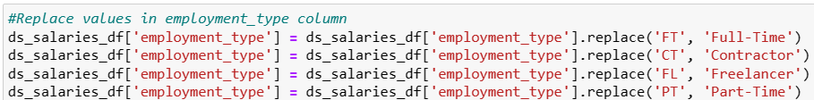
5. Replacing values
To enhance comprehension, interpretation, and analysis, we have substituted abbreviations with their corresponding full forms.

Slide 16

EXPLORATORY DATA ANALYSIS

Slide 17
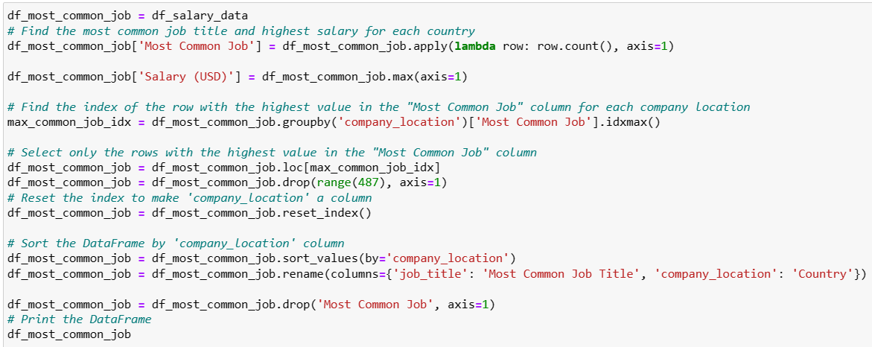
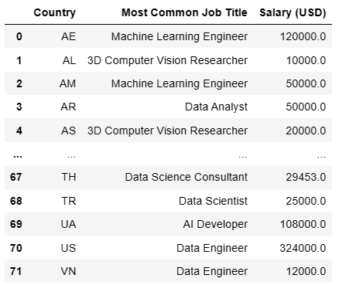
Trendiest Job Title: Which is the trendiest job title by country?
This analysis helps us make informed decision about the job market in our "Dream work location".

Slide 18
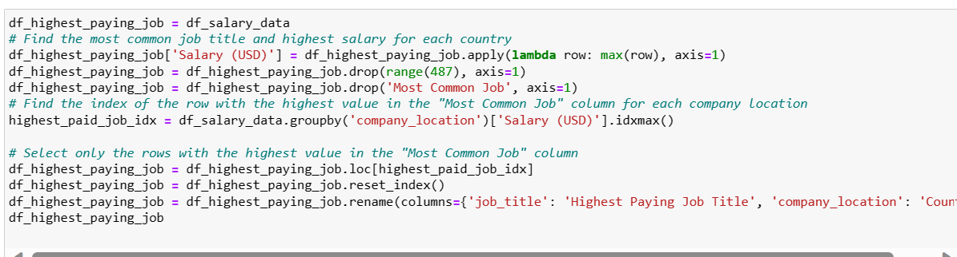
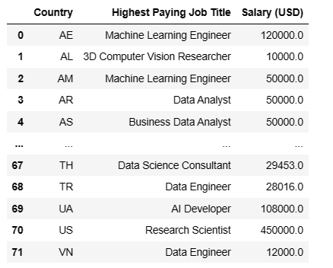
Lucrative Job Title: Which is the most lucrative job title by country?
This analysis empowers us with the knowledge necessary to target our "Dream Salary”.

Slide 19
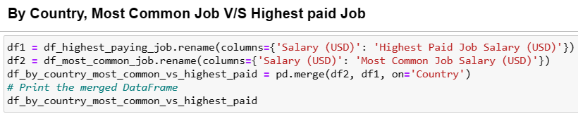
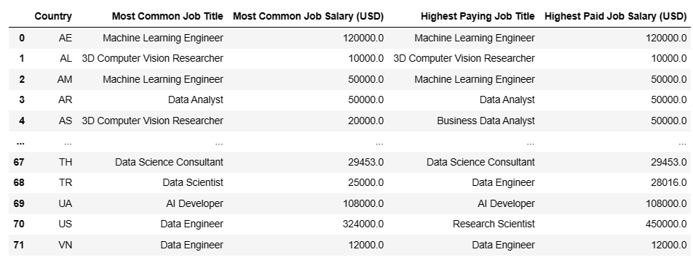
This analysis guides us to make optimal job choice with respect to salary.
Best used during job switching.

Slide 20
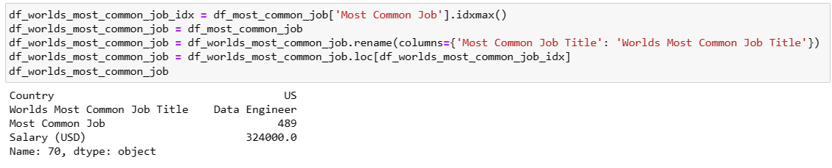
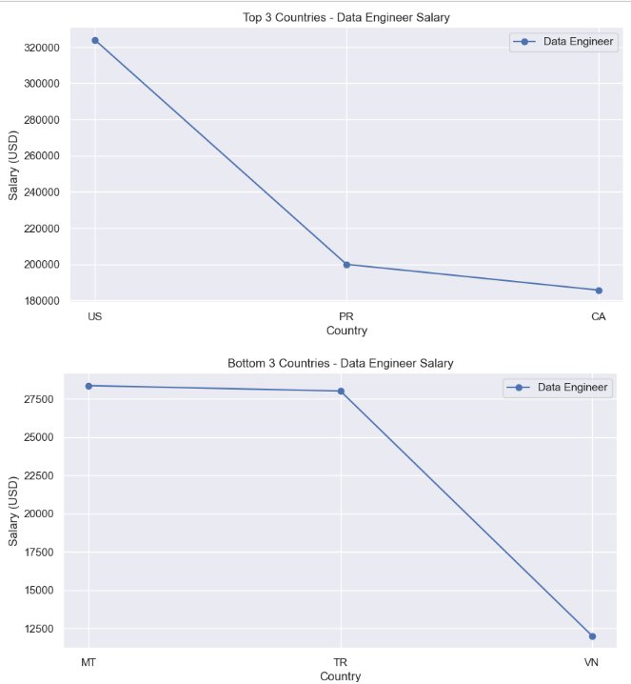
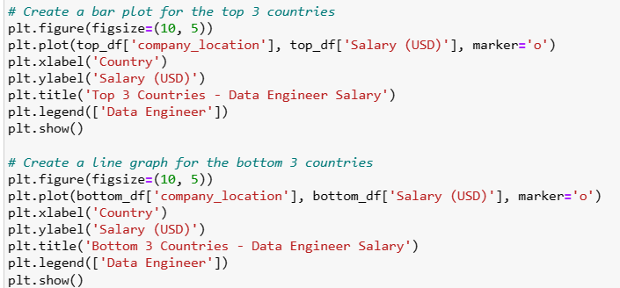
Demographic Pay Gaps: Are there any pay gaps related to most common job title in the world?
We see that there is definite pay-gap for the most common job title in the world.
Data Engineer :
US highest ($325k), Vietnam lowest ($12k)

Slide 21
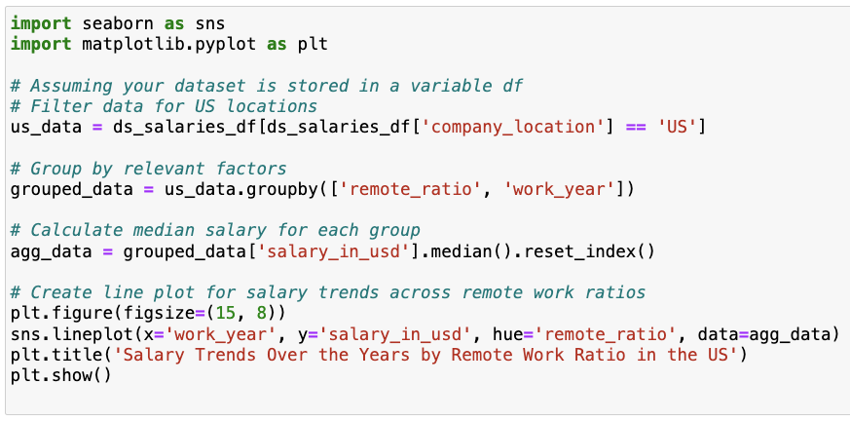
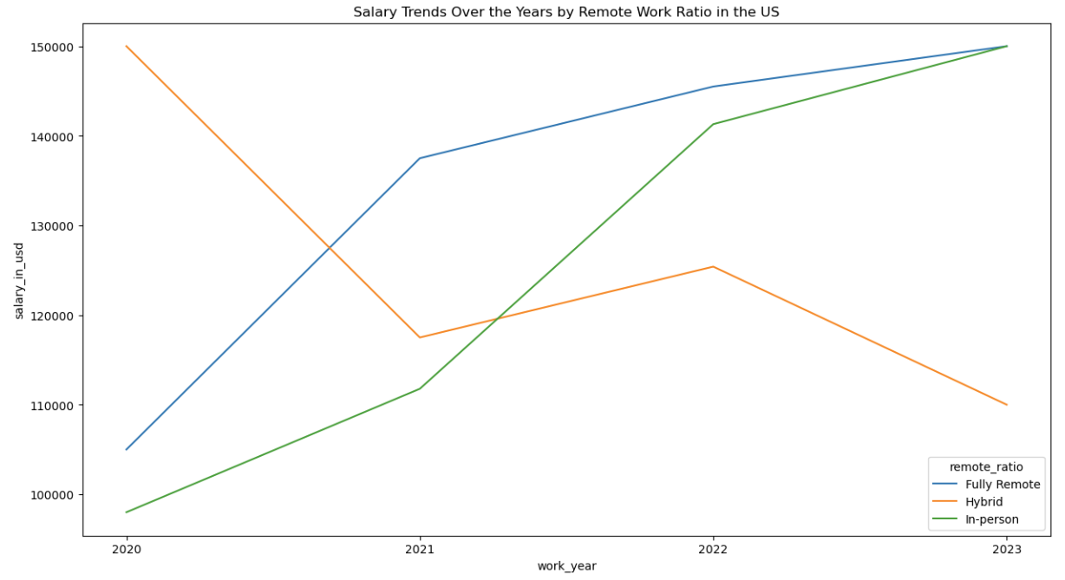
Impact of remote_ratio column: Does work modality have any significant impact on salaries?
Work modes: fully remote, hybrid, in-person
During the peak pandemic years of 2020 and 2021, remote workers' median salaries surged. Surprisingly, in 2022 and 2023, despite the return to in-person work, remote job compensation continued to rise.
By 2023, median salaries for in-person and remote work equalized, showing no difference. However, hybrid work experienced a sharp decline in median salary, becoming the least lucrative option.

Slide 22
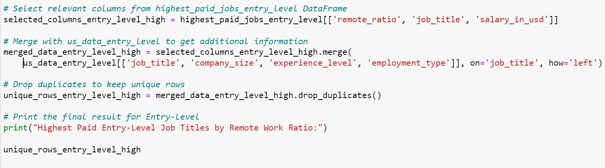
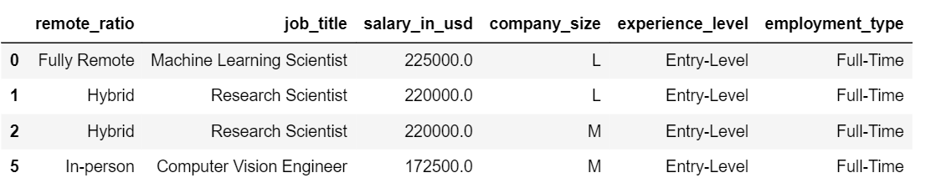
Highest paid remote_ratio entry level positions: Which are the highest paid entry level jobs in US in 2023 as per work modality?
NOTE: We have chosen US company location because we believe that majority of our classmates would want to work in the US after graduation.

Slide 23
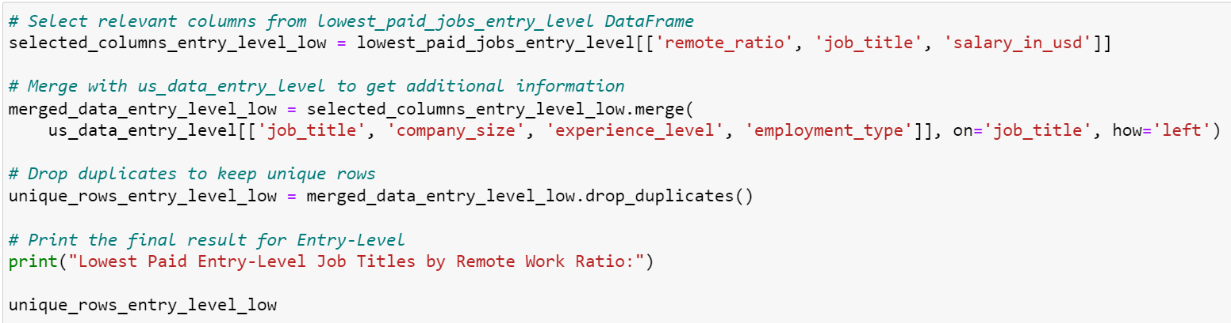
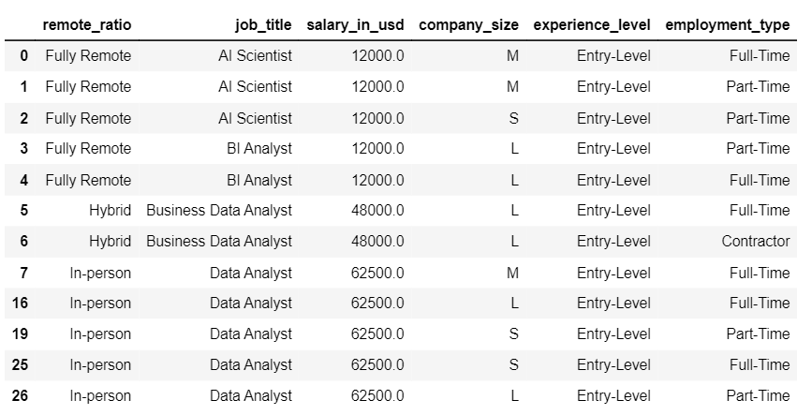
Lowest paid remote_ratio entry level positions: Which are the lowest paid entry level jobs in US in 2023 as per work modality?

Slide 24
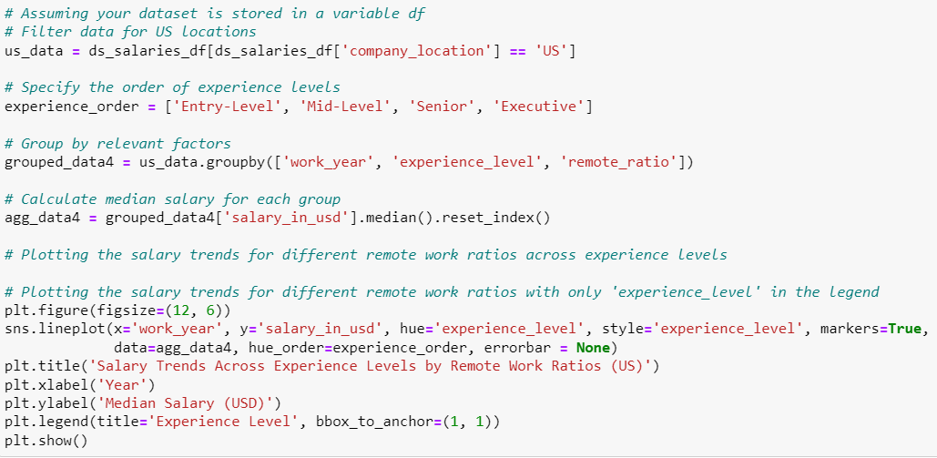
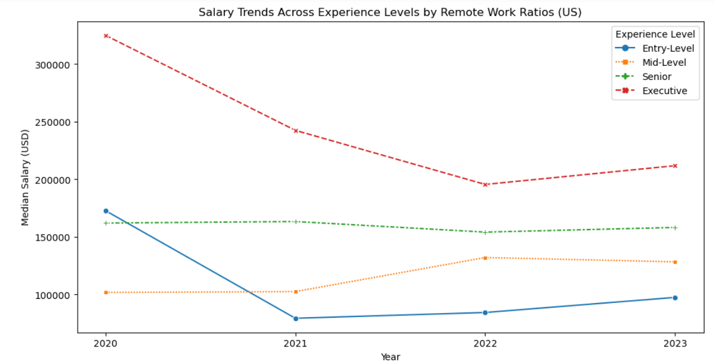
Impact of experience and remote_ratio: Did experience levels play a role in salary trends as per different work modes?
Entry and executive-level median salaries declined significantly during the peak pandemic years from 2020 to 2021 and showed minimal growth from 2022 to 2023. Meanwhile, senior-level salaries consistently increased and mid-level salaries grew from 2021 to 2022 as the pandemic eased.

Slide 25
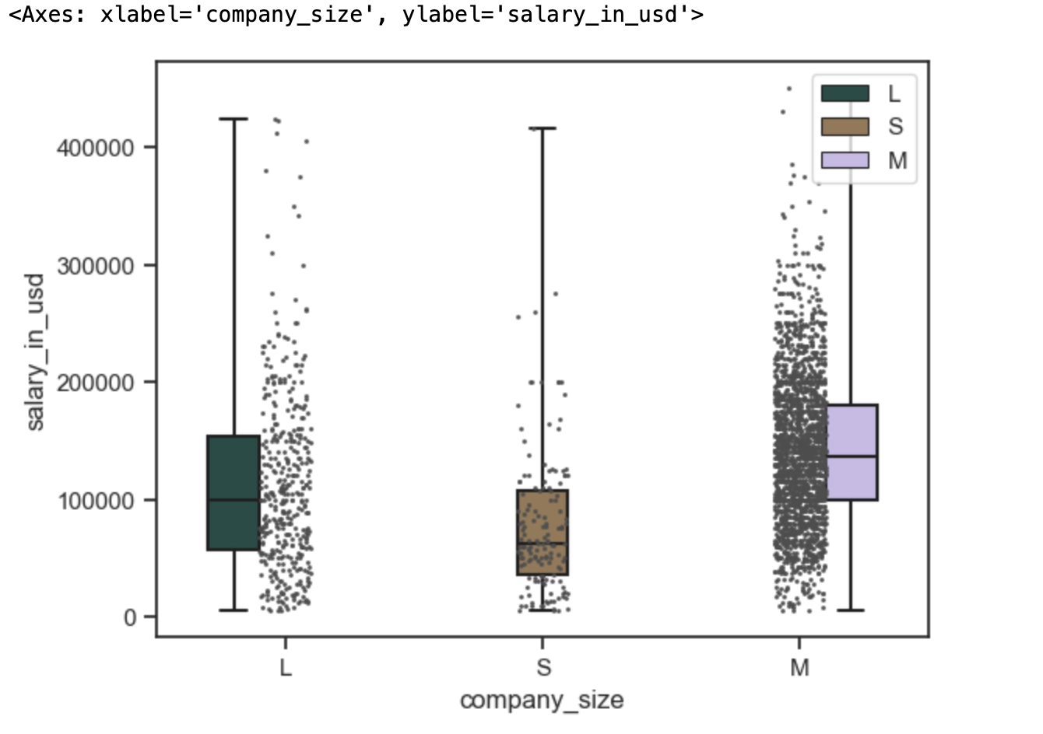
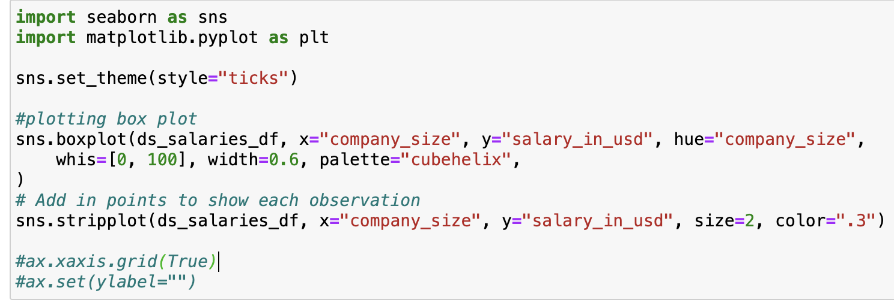
Salary variation based on company size: Do salaries vary by company size (small, medium, and large)?
Medium sized companies lead in data science employment rate, with higher median salary ranges compared to both large and small firms, as indicated by the box plot.

Slide 26
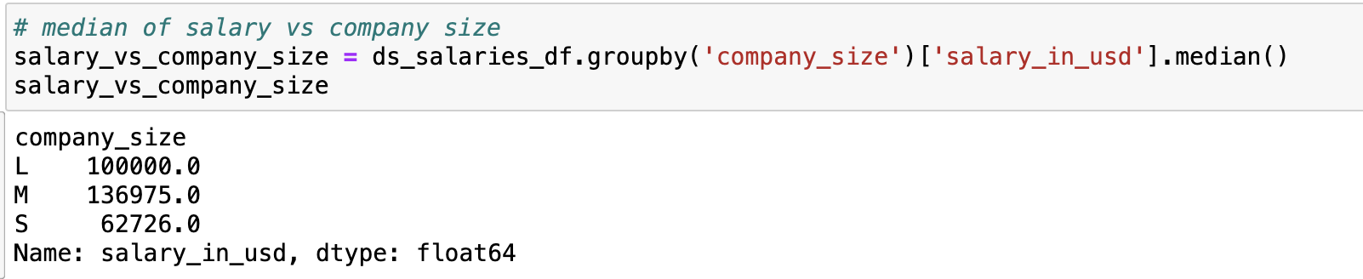
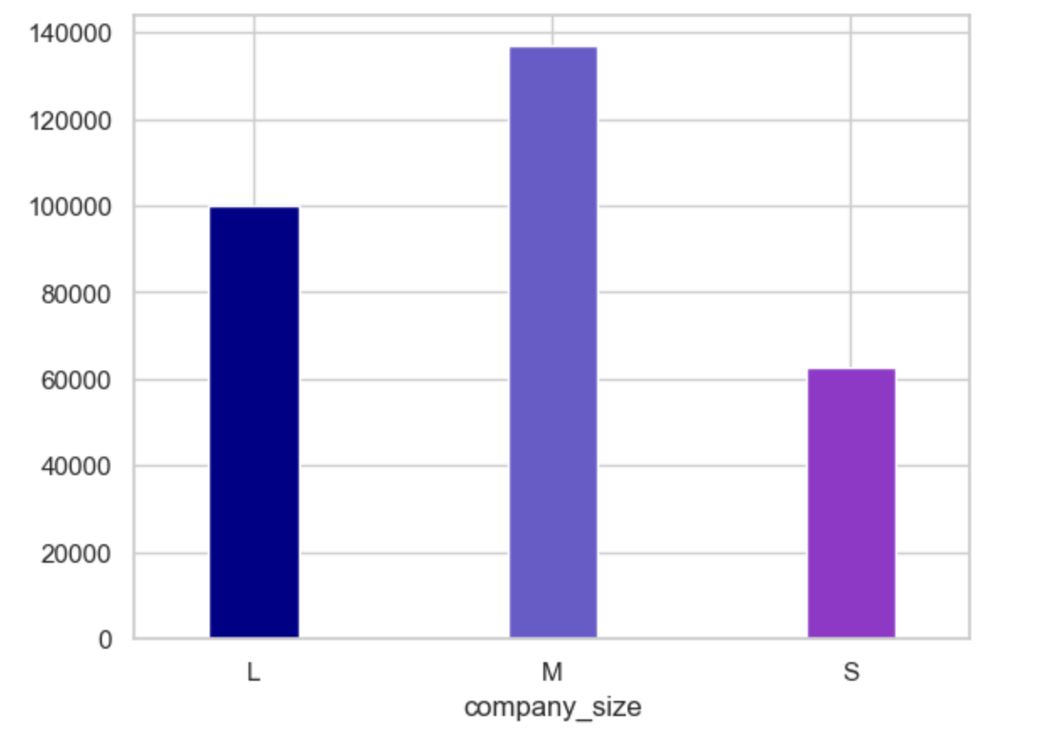
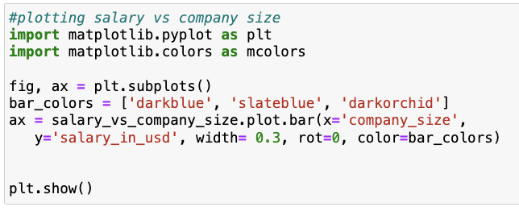
Salary variation based on company size: How is salary distributed across companies based on their sizes?
Medium sized companies offer higher median salaries than both large and small companies.

Slide 27
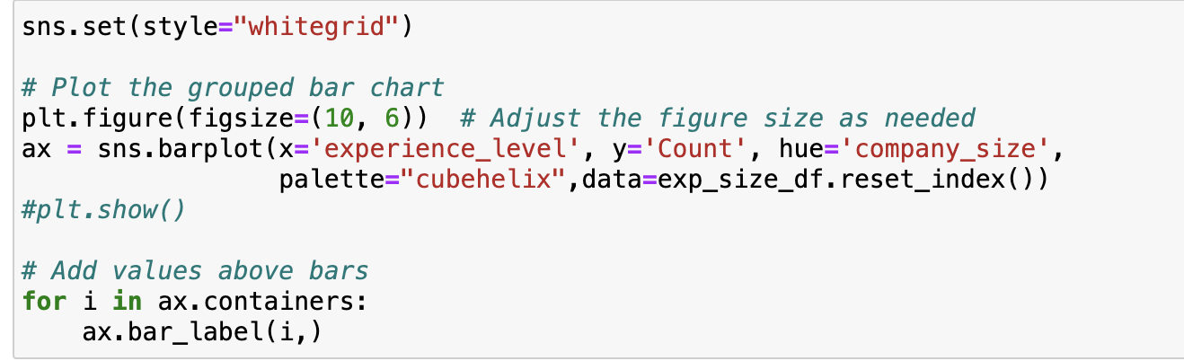
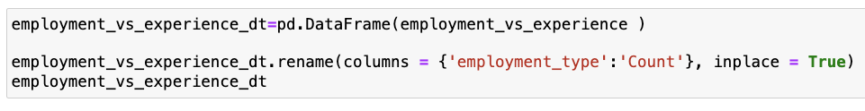
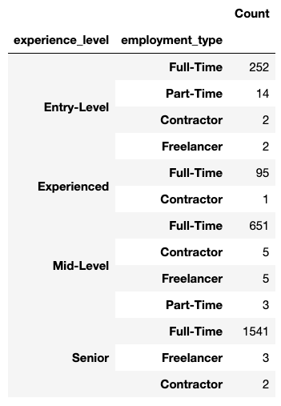
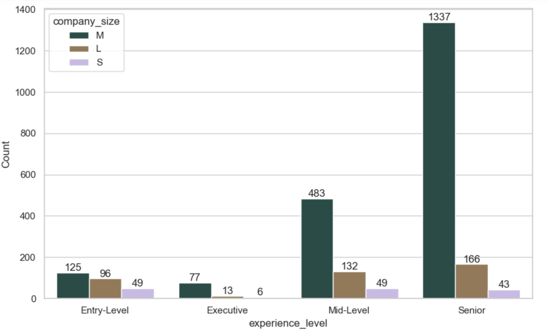
Employment types and experience: What sizes of companies are attracting most of the data science-related jobs? Is there any relationship between company size and experience level?
Mid-Sized Companies :
Seniors > Mid-level > Entry-Level > Executives
Large Sized Companies:
Seniors > Mid-Level > Entry-Level > Executives
Small-Sized Companies:
Entry-Level = Mid-Level > Senior > Executives

Slide 28
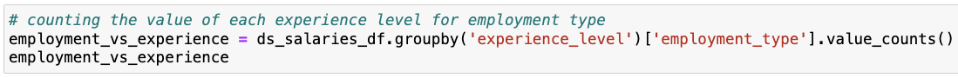
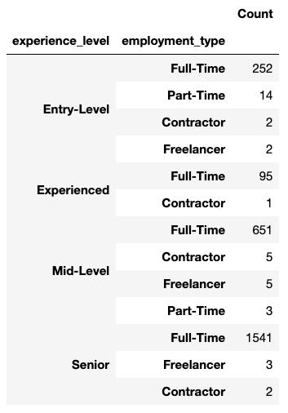
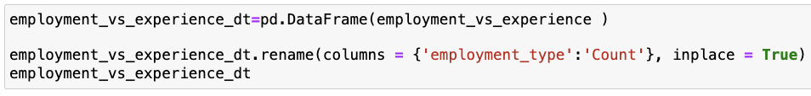
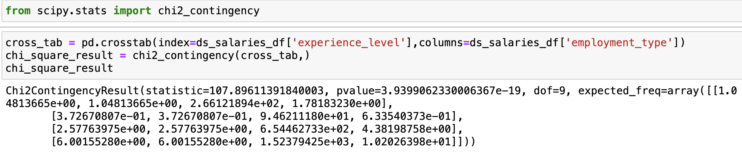
Employment types and experience: Do employment types have a dependency on experience?
We are using a chi-square test as we are trying to find correlation between two categorical variables.
H0 - The two columns are not correlated ;
H1 - The two columns are correlated
Result - The probability of H0 being true
In this case, since p-value is very less (in comparison of alpha, say 0.05), we will reject the H0 and conclude that the two columns are correlated

Slide 29
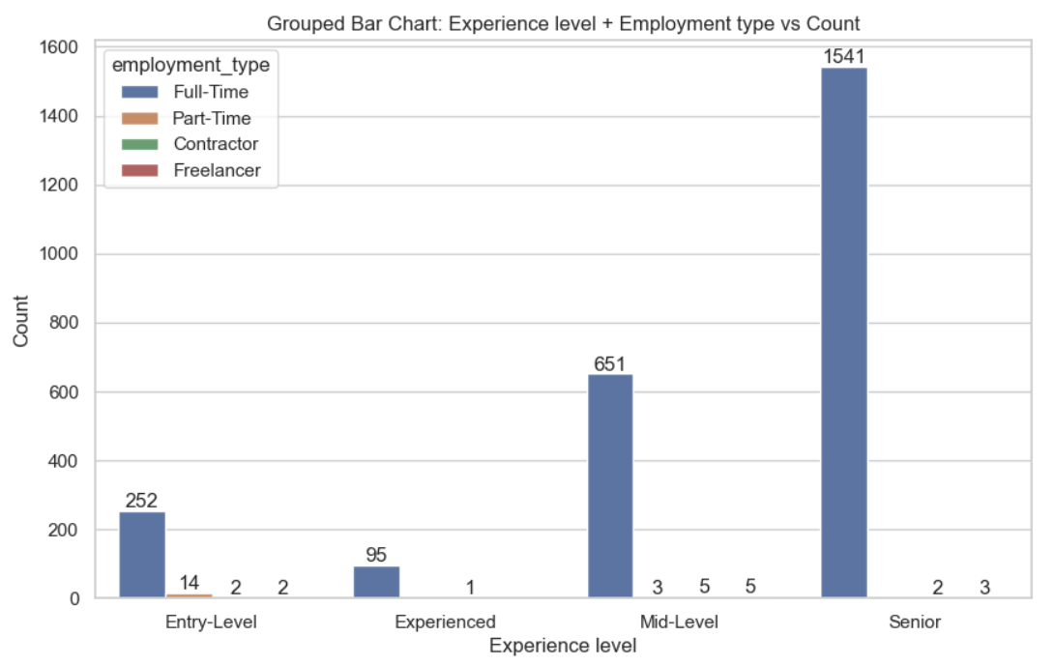
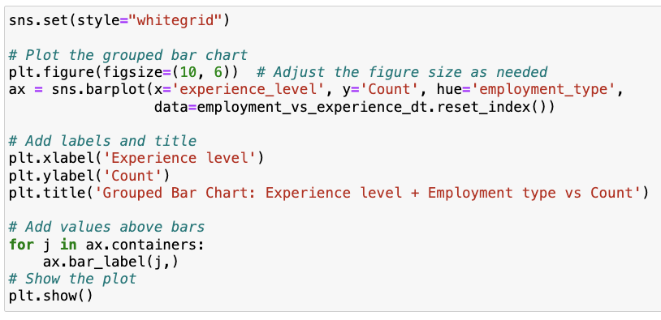
Employment types and experience: Do employment types have a dependency on experience?
Majority of companies offer full time roles for data science jobs, especially for senior level roles.

Slide 30
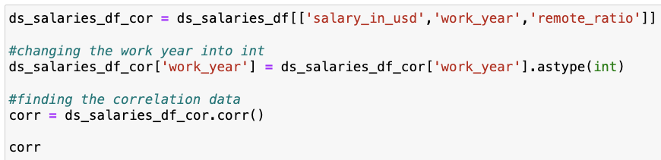
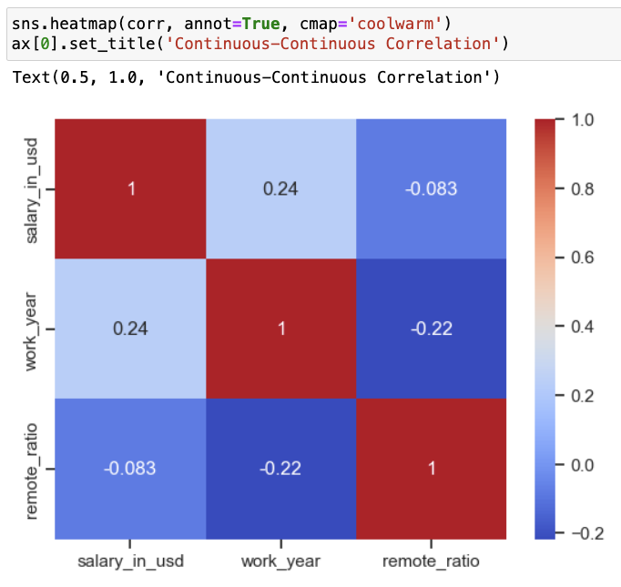
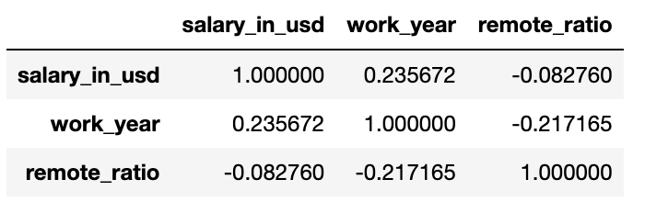
Finding correlation between numerical values of the dataset
Remote ratio and work year are weak predictors for salary (in USD), given their correlation ratio is quite low: 0.24 and -0.083.

Slide 31
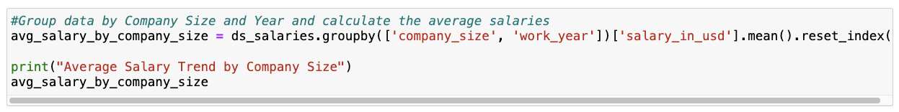
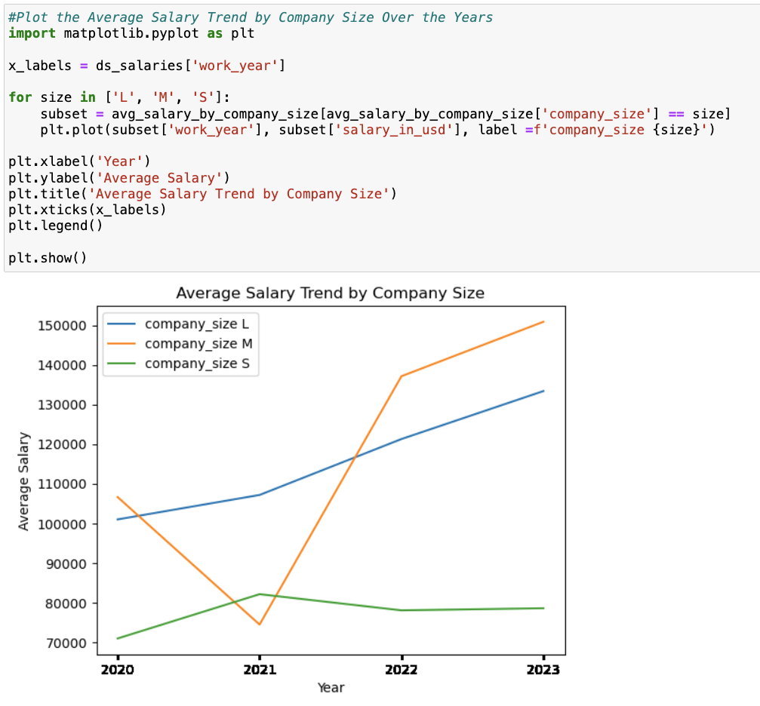
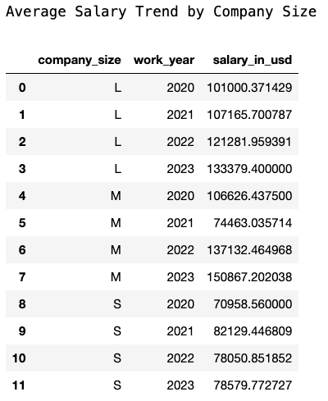
Compensation trends: Are organizations staying up-to-date with the compensation trends in the industry?
The overall average salary trend by company size seems to be gradually increasing over the years. However, company size S and M had a spike and a drop in 2021.

Slide 32
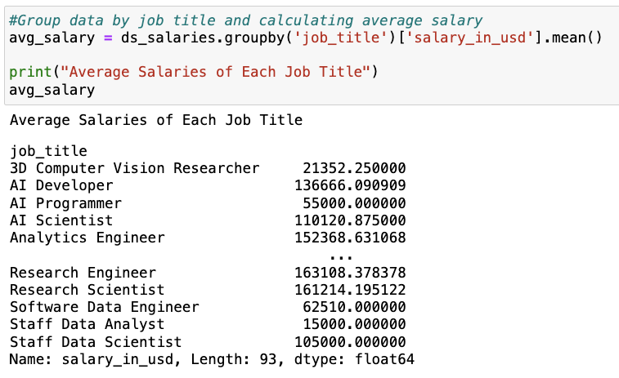
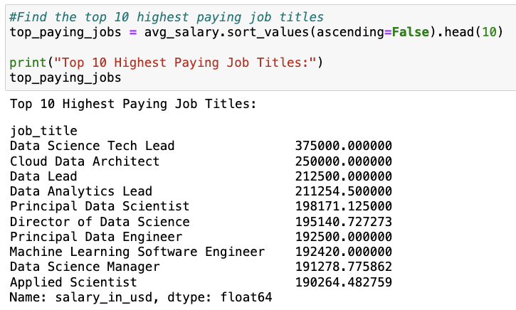
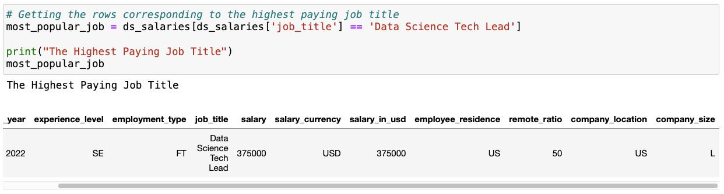
Compensation trends: What kind of talent are companies looking for based on the highest paying job title?
First, we need to calculate the average salaries of each job title to find the highest paying job title.
Then, retrieve the information about the highest paying job title from the dataset.
Data Science Tech Lead
Experience level: Senior
Employment tyle: Full time
Employee residence: US
Company size: L

Slide 33


Salary trends over the years: Can we identify trends in salaries over time, such as year-over-year growth or fluctuations?
The overall salary trend over the years had the most significant increase in 2022, suggesting that data science is on the rise.

Slide 34


Salary trends over the years: What does the salary trend for Data Analysts look like over the years?
The salary trend for Data Analysts significantly increased over the years, doubling from 2020 to 2022.

Slide 35


Salary trends over the years: What does the salary trend for BI (Data) Analyst look like over the years?
There’s an interesting salary trend for BI Analysts and BI Data Analysts over the years, declining from 2020 to 2022 and increasing from 2022 to 2023.

Slide 36

DATA MODELING

Slide 37

Chosen model: Multiple linear regression
Purpose: Predict average salaries for different job titles in the US for 2024
Benefit: Understand how categorical factors influence salaries
Insights: Provide clear understanding of predictors' impact on average salary
Aim: Assist classmates in making informed career decisions by considering all factors during their 2024 job hunt in the US

Slide 38

STEPS FOR CREATING THE MODEL

Slide 39


PREPARE DATA
We filtered data exclusively for US company locations and then found out the average salaries of the various job titles identified in US.

Slide 40



2. MULTIPLE LINEAR REGRESSION USING SKLEARN
We used one-hot encoding to handle the categorical variables.
3. FIT THE MODEL

Slide 41


4. PREDICT AVERAGE SALARIES FOR 2024
Reapplying one-hot encoding in the prediction phase ensures the model interprets new data ('avg_salary_2024') accurately, aligning with its learned encoding from training.
This data frame displays the average salaries for 2024 for data science job titles based in the US.

Slide 42



OUTPUT : PART 1
Which job titles have an upward salary trend (2023 to 2024)?
The following job titles all have an upward salary trend in 2024, of which Applied Machine Learning Scientist being the highest.

Slide 43


OUTPUT : PART 2
Which job titles have a constant salary trend from 2023 to 2024?

Slide 44


OUTPUT : PART 3
Which job titles have a downward salary trend from 2023 to 2024?
The following job titles all have a downward salary trend in 2024, of which Computer Vision Engineer being the lowest.
NOTE: Some bars may not be visible because the salary difference is lower than others.

Slide 45

CONCLUSION
Job Title Selection: Students are recommended to pursue common and high-paying job titles to optimize their career.
Influential Factors: The main factors that have influence on compensation are company location, company size, and experience level.
Salary Trends: For 2024, our predictive model suggests that there could be an overall increase in salary trends in data science job titles such as Research Scientist and Applied Machine Learning Scientist. It is important to note that certain job titles might experience downward trends or no change at all.

Slide 46


